Slide 1

Natural Language Processing with Deep Learning CS5542- Lecture 4

Slide 2
1. What is Natural Language Processing (NLP)?
Natural language processing is a field at the intersection of
computer science
artificial intelligence
and linguistics.
Goal: for computers to process or “understand” natural language in order to perform tasks that are useful, e.g.,
Performing Tasks, like making appointments, buying things
Language translation
Question Answering
Siri, Google Assistant, Facebook M, Cortana …
Fully understanding and representing the meaning of language (or even defining it) is a difficult goal.
Perfect language understanding is AI-complete

Slide 3
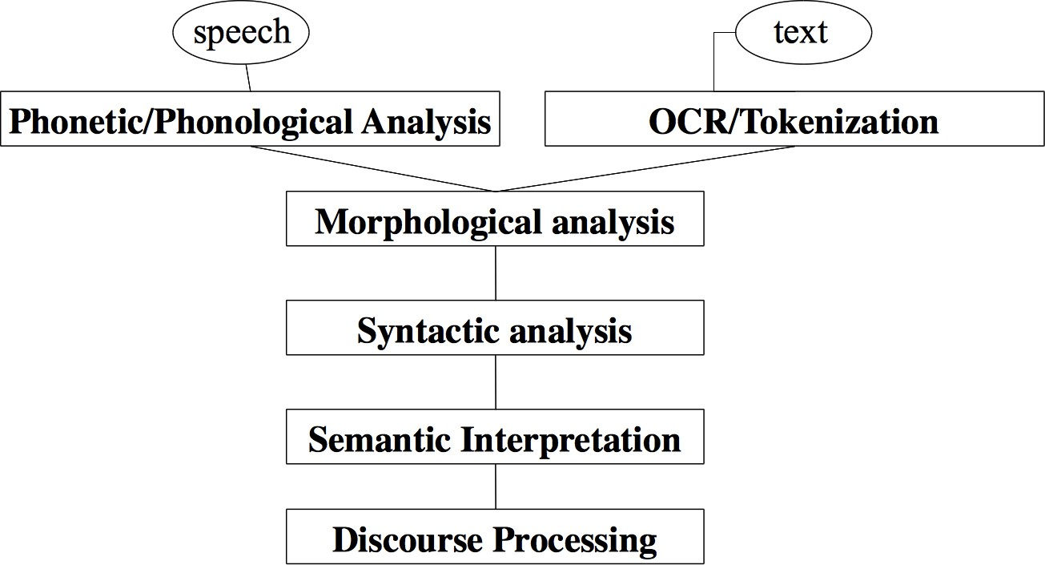
NLP Levels

Slide 4
(A tiny sample of) NLP Applications
Applications range from simple to complex:
Spell checking, keyword search, finding synonyms
Extracting information from websites such as
product price, dates, location, people or company names
Classifying: reading level of school texts, positive/negative sentiment of longer documents
Machine translation
Spoken dialog systems
Complex question answering

Slide 5
NLP in industry … is taking off
Search (written and spoken)
Online advertisement matching
Automated/assisted translation
Sentiment analysis for marketing or finance/trading
Speech recognition
Chatbots / Dialog agents
Automating customer support
Controlling devices
Ordering goods

Slide 6
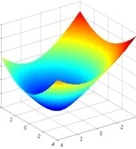
2. What’s Deep Learning (DL)?
Deep learning is a subfield of machine learning
Most machine learning methods work well because of human-designed representations and input features
For example: features for finding named entities like locations or organization names (Finkel et al., 2010):
Machine learning becomes just optimizing weights to best make a final prediction
Feature | NER
Current Word | C
Previous Word | C
Next Word | C
Current Word Character n-gram | all
Current POS Tag | C
Surrounding POS Tag Sequence | C
Current Word Shape | C
Surrounding Word Shape Sequence | C
Presence of Word in Left Window | size 4
Presence of Word in Right Window | size 4

Slide 7




Machine Learning vs. Deep Learning
Machine Learning in Practice
Describing your data with features a computer can understand
Learning algorithm
Domain specific, requires Ph.D. level expertise
Optimizing the weights on features

Slide 8
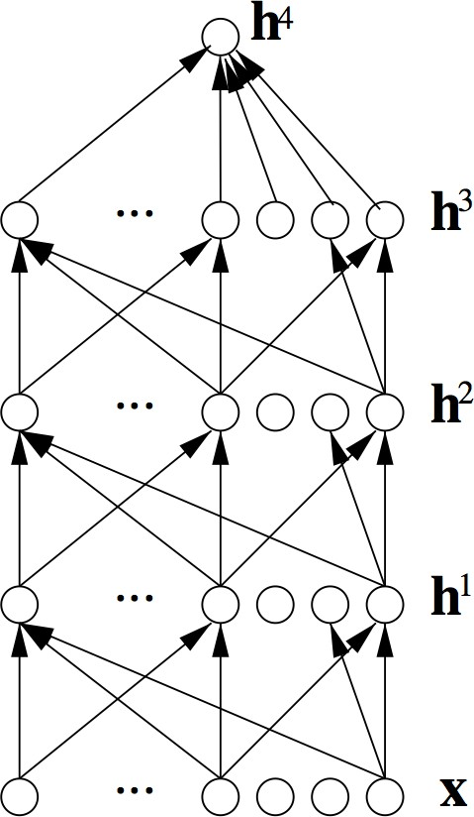
What’s Deep Learning (DL)?
In contrast to standard machine learning,
Representation learning attempts to automatically learn good features or representations
Deep learning algorithms attempt to learn (multiple levels of) representations (here: h¹,h²,h³) and an output (h⁴)
From “raw” inputs x
(e.g. sound, pixels, characters, or words)

Slide 9
On the history of “Deep Learning”
We will not take a historical approach but instead focus on methods which work well on NLP problems now
For a long history of deep learning models (starting ~1960s), see: Deep Learning in Neural Networks: An Overview
by Jürgen Schmidhuber

Slide 10
Reasons for Exploring Deep Learning
Manually designed features are often over-specified, incomplete and take a long time to design and validate
Learned Features are easy to adapt, fast to learn
Deep learning provides a very flexible, (almost?) universal, learnable framework for representing world, visual and linguistic information.
Deep learning can learn unsupervised (from raw text) and
supervised (with specific labels like positive/negative)

Slide 11
Reasons for Exploring Deep Learning
In ~2010 deep learning techniques started outperforming other machine learning techniques. Why this decade?
Large amounts of training data favor deep learning
Faster machines and multicore CPU/GPUs favor Deep Learning
New models, algorithms, ideas
Better, more flexible learning of intermediate representations
Effective end-to-end joint system learning
Effective learning methods for using contexts and transferring between tasks
Better regularization and optimization methods
→ Improved performance (first in speech and vision, then NLP)

Slide 12


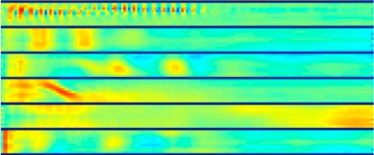
Deep Learning for Speech
The first breakthrough results of “deep learning” on large datasets happened in speech recognition
Context-Dependent Pre-trained Deep Neural Networks for Large Vocabulary Speech Recognition Dahl et al. (2010)
Phonemes/Words

Slide 13
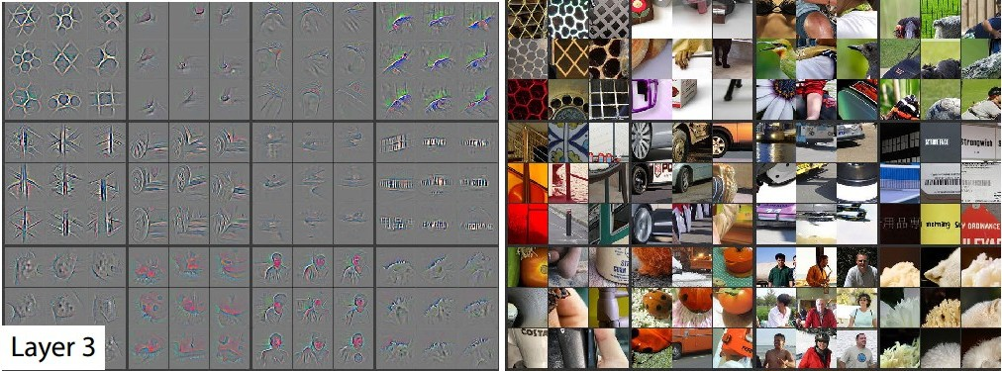
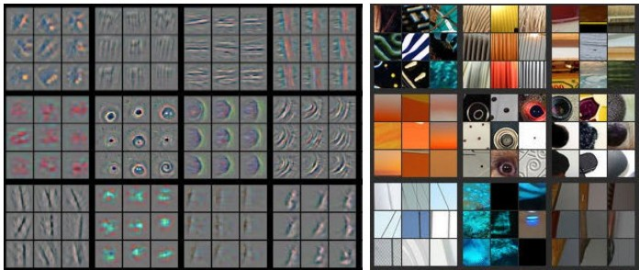

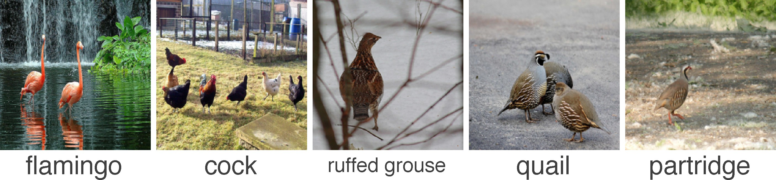
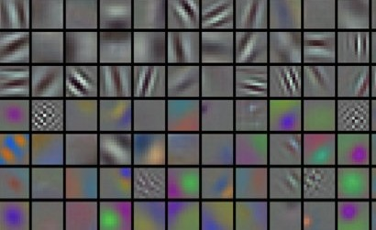
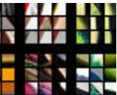
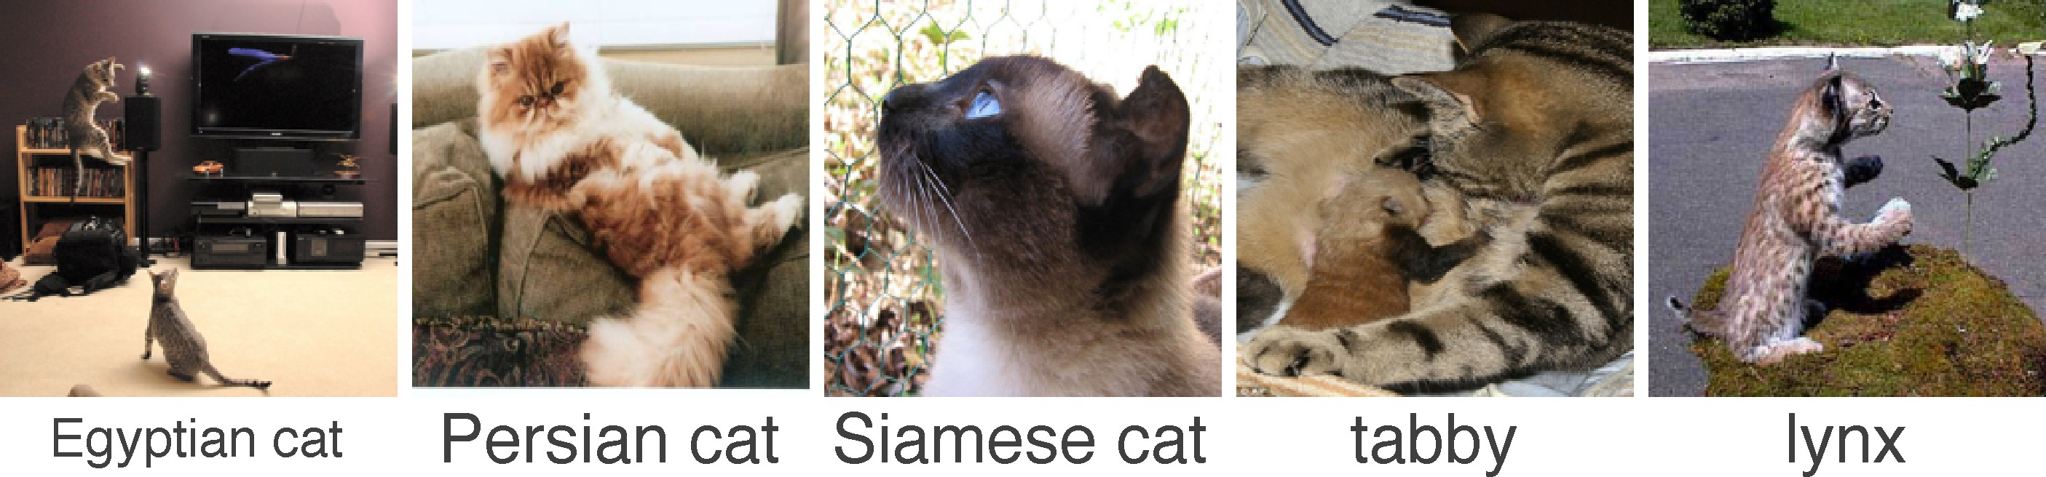

Deep Learning for Computer Vision
First major focus of deep learning groups was computer vision
The breakthrough DL paper: ImageNet Classification with Deep Convolutional Neural Networks by Krizhevsky, Sutskever, & Hinton, 2012, U. Toronto. 37% error red.
···
Zeiler and Fergus (2013)
···

Slide 14
4. Why is NLP hard?
Complexity in representing, learning and using linguistic/situational/contextual/world/visual knowledge
But interpretation depends on these
Human languages are ambiguous (unlike programming and other formal languages)
E.g. “I made her duck.”

Slide 15
5. Deep NLP = Deep Learning + NLP
Combine ideas and goals of NLP with using representation learning and deep learning methods to solve them
Several big improvements in recent years in NLP
Linguistic levels: (speech), words, syntax, semantics
Intermediate tasks/tools: parts-of-speech, entities, parsing
Full applications: sentiment analysis, question answering, dialogue agents, machine translation

Slide 16
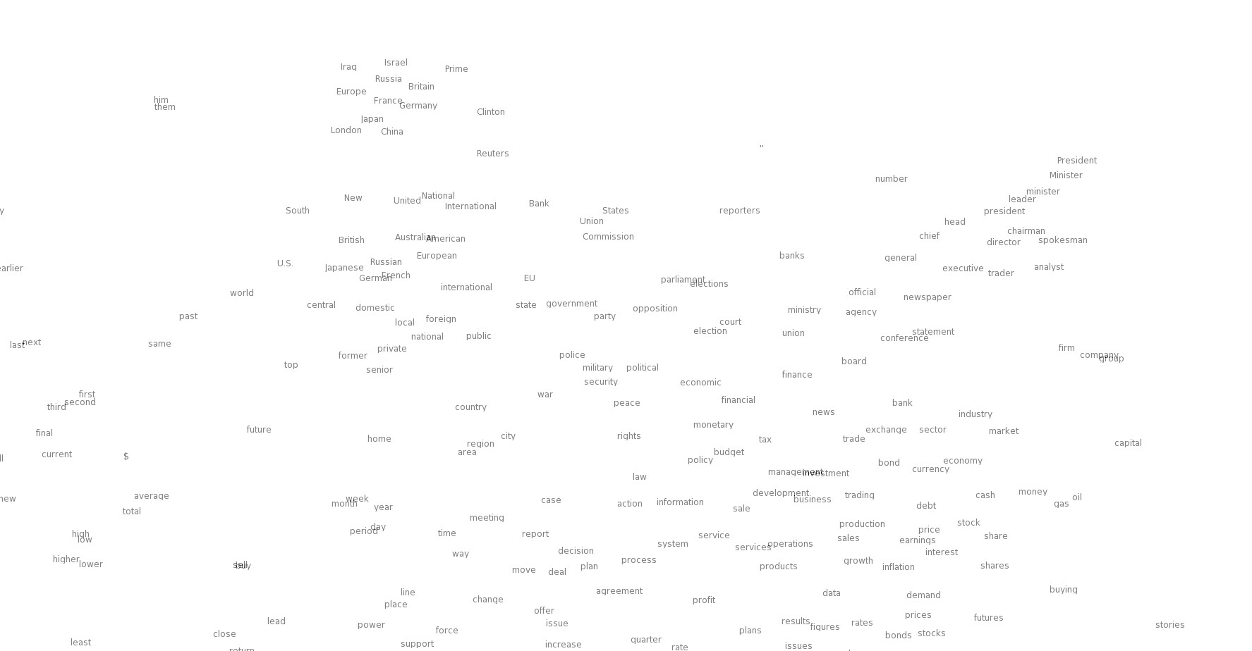
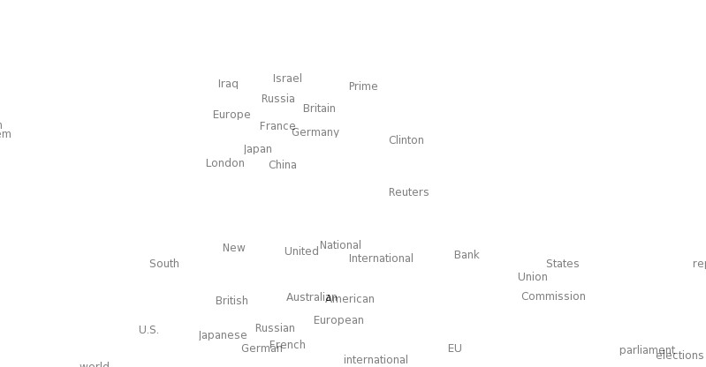

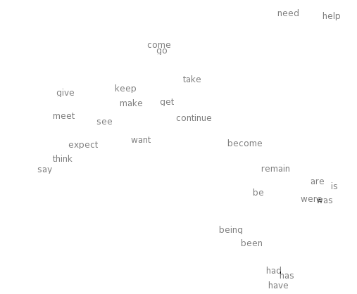
Word meaning as a neural word vector – visualization
0.286
0.792
−0.177
−0.107
0.109
−0.542
0.349
0.271
0.487
expect =

Slide 17
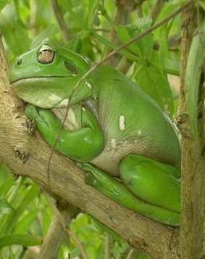

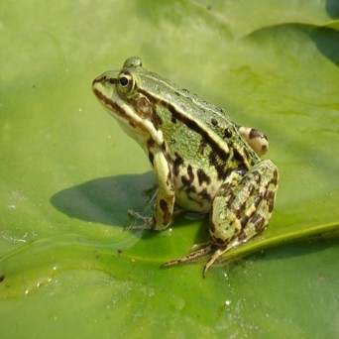
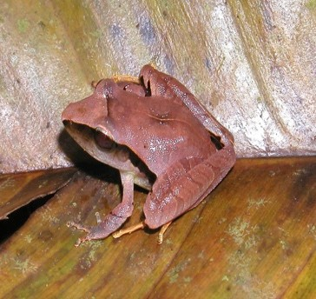
Word similarities
Nearest words to frog:
frogs
toad
litoria
leptodactylidae
rana
lizard
eleutherodactylus
litoria
leptodactylidae
eleutherodactylus
1/9/18
rana
²h⁹ttp://nlp.stanford.edu/projects/glove/

Slide 18
Representations of NLP Levels: Morphology
Traditional: Words are prefix stem made of morphemes un
suffix
interest ed
DL:
every morpheme is a vector
a neural network combines two vectors into one vector
Luong et al. 2013
unfortunately_{STM}
W , b
n n
unfortunate_{STM}
W_{n}, b_{n}
^{ly}SUF
^{un}PRE
fortunate_{STM}

Slide 19
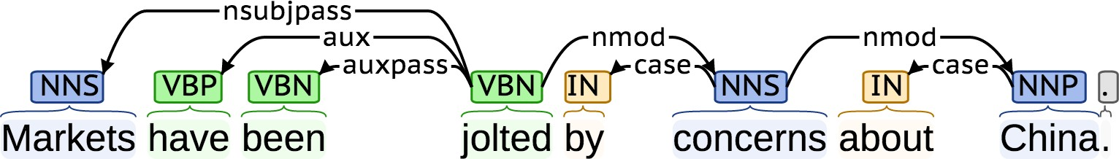
NLP Tools: Parsing for sentence structure
Neural networks can accurately determine the grammatical structure of sentences
This supports interpretation and may help in disambiguation

Slide 20
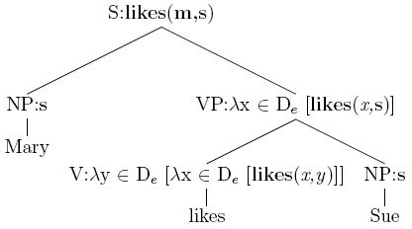
Representations of NLP Levels: Semantics
Traditional: Lambda calculus
Carefully engineered functions
Take as inputs specific other functions
No notion of similarity or fuzziness of language
DL:
Every word and every phrase and every logical expression is a vector
a neural network combines two vectors into one vector
Bowman et al. 2014
Softmax classifier
P (@)= 0.8
Comparison N(T)N layer
all reptiles walk vs. some turtles move
Composition
all reptiles walk
some turtles move
RN(T)N
layers
all reptiles
walk
some turtles
move
all
reptiles
some
turtles

Slide 21

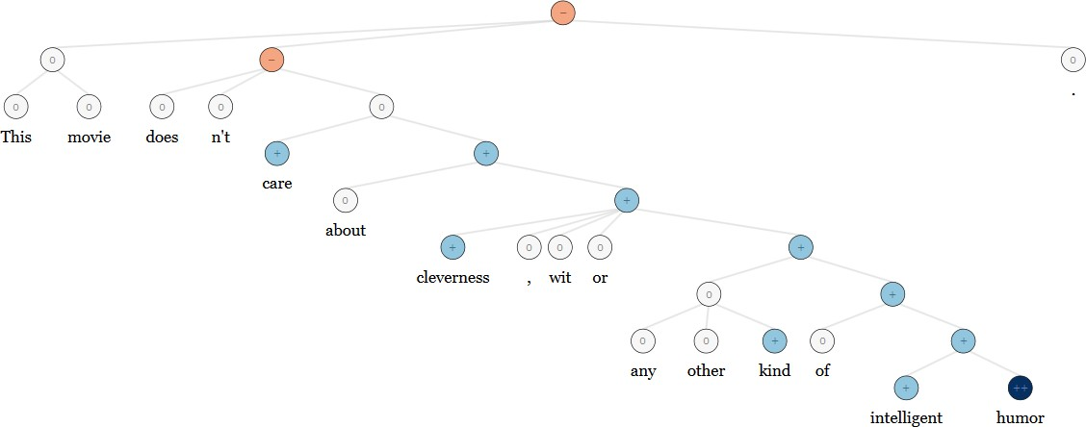
NLP Applications: Sentiment Analysis
Traditional: Treat sentence as a bag-of-words (ignore word order); consult a curated list of "positive" and "negative" words to determine sentiment of sentence. Need hand-designed features to capture negation! --> Ain’t gonna capture everything
Same deep learning model that could be used for morphology, syntax and logical semantics → RecursiveNN (aka TreeRNNs)

Slide 22
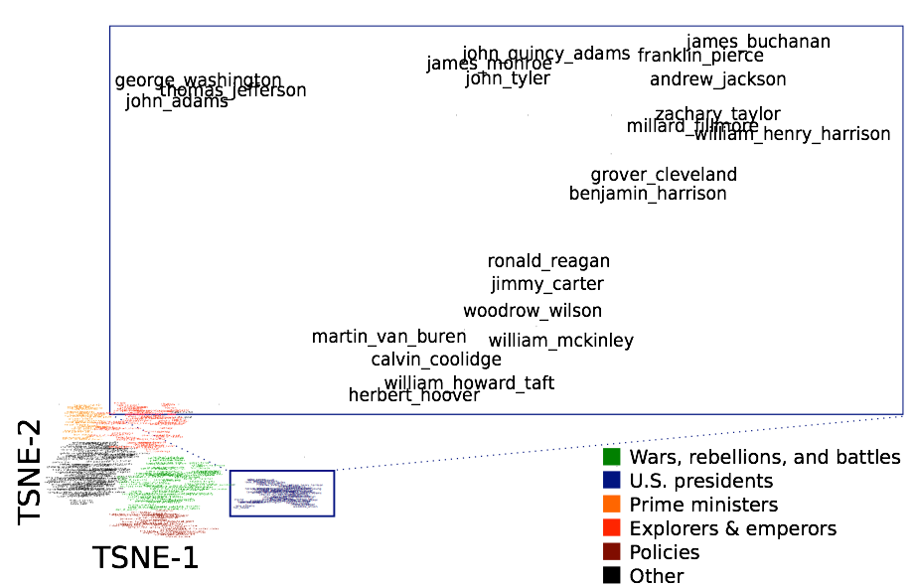
Question Answering
Traditional: A lot of feature engineering to capture world and other knowledge, e.g., regular expressions, Berant et al. (2014)
Is main verb trigger?
Yes No
Condition | Regular Exp.
Wh- word subjective? Wh- word object? | AGENT THEME
Condition | Regular Exp.
default DIRECT PREVENT | (ENABLE|SUPER)⁺ (ENABLE|SUPER) (ENABLE|SUPER)⇤ PREVENT(ENABLE|SUPER)⇤
DL: Again, a deep learning architecture can be used!
Facts are stored in vectors

Slide 23







Dialogue agents / Response Generation
A simple, successful example is the auto-replies available in the Google Inbox app
An application of the powerful, general technique of Neural Language Models, which are an instance of Recurrent Neural Networks

Slide 24
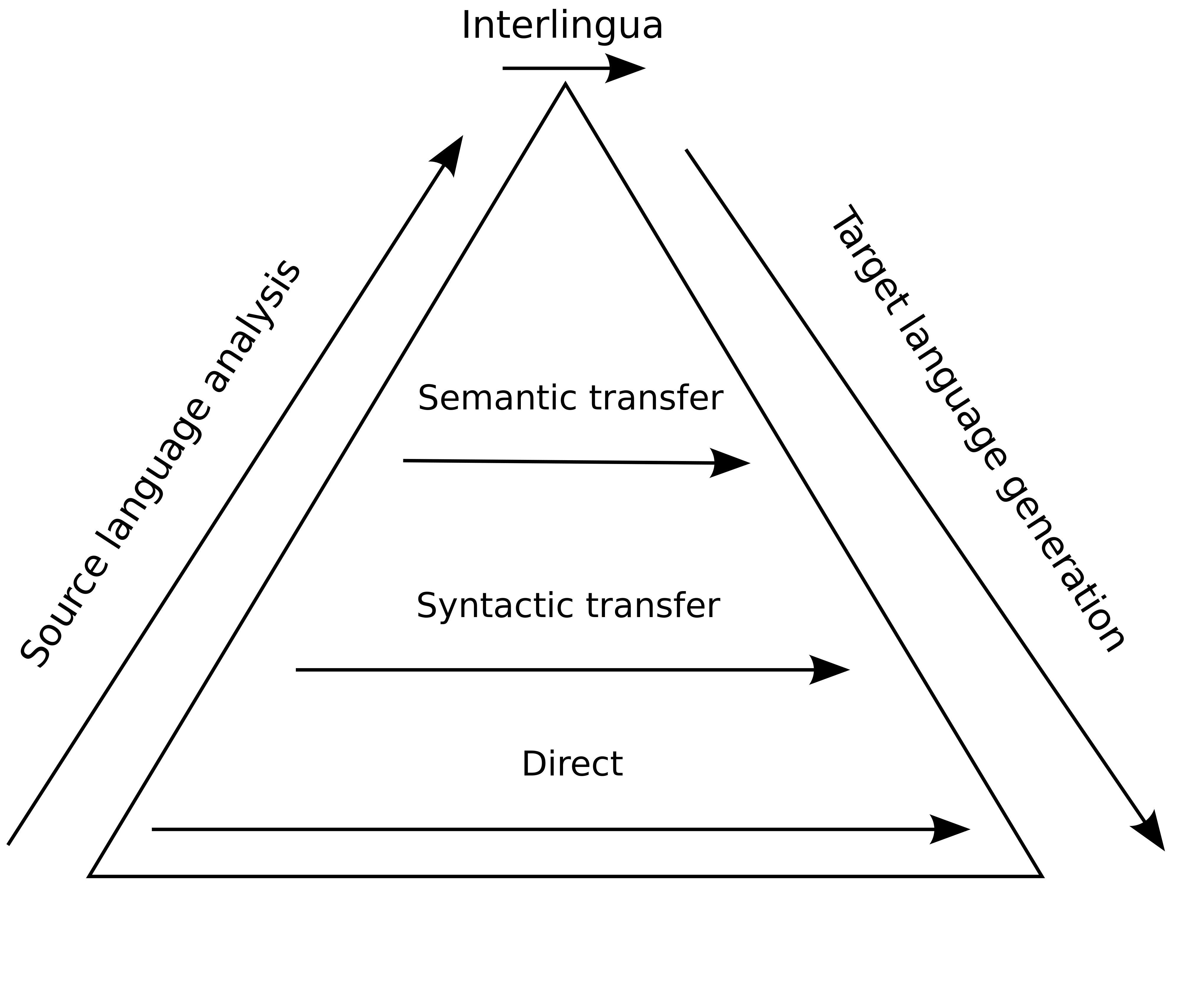
Machine Translation
Many levels of translation have been tried in the past:
Traditional MT systems are very large complex systems

Slide 25
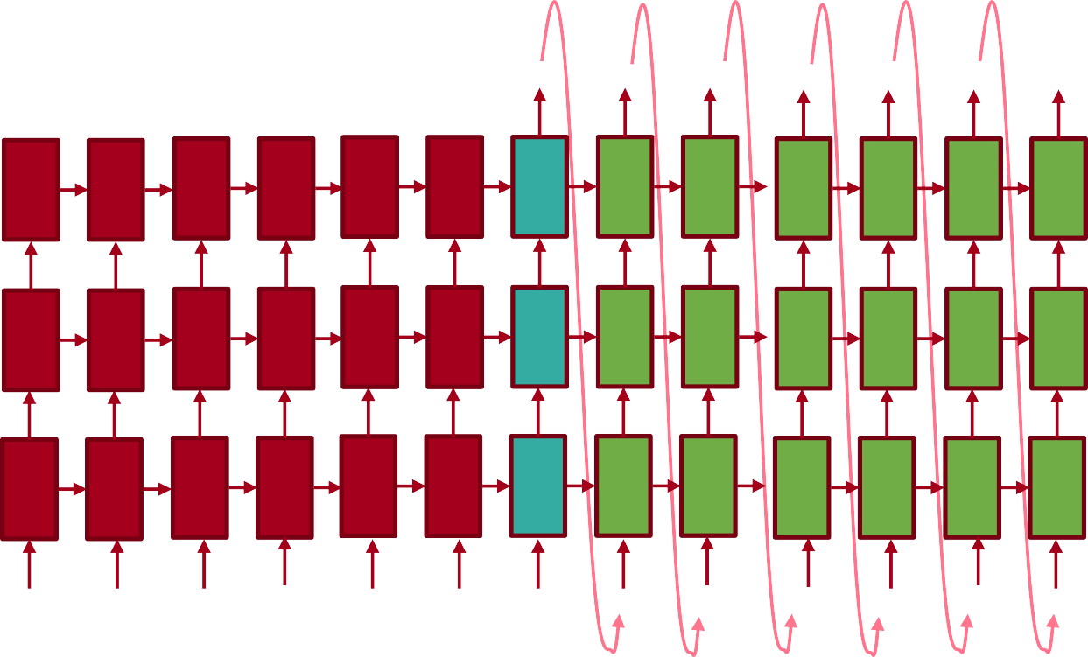
Neural Machine Translation
Source sentence is mapped to vector, then output sentence generated [Sutskever et al. 2014, Bahdanau et al. 2014, Luong and Manning 2016]
Translation generated
The protests escalated
over
the weekend <EOS>
0.1 | 0.2 | 0.4 | 0.5 | 0.2 | -0.1 | 0.2 | 0.2 | 0.3 | 0.4 | -0.2 | -0.4 | -0.3
0.3 | 0.6 | 0.4 | 0.5 | 0.6 | 0.6 | 0.6 | 0.6 | 0.6 | 0.4 | 0.6 | 0.6 | 0.5
0.1 | -0.1 | 0.3 | 0.9 | -0.1 | -0.1 | -0.1 | -0.1 | -0.1 | -0.1 | -0.1 | -0.1 | -0.1
-0.4 | -0.7 | -0.2 | -0.3 | -0.5 | -0.7 | -0.7 | -0.7 | -0.7 | -0.7 | -0.7 | -0.7 | -0.7
0.2 | 0.1 | -0.3 | -0.2 | 0.1 | 0.1 | 0.1 | 0.1 | 0.1 | 0.1 | 0.1 | 0.1 | 0.1
Sentence meaning is built up
0.2 -0.2 | 0.2 0.6 | 0.1 0.3 | 0.2 0.6 | 0.2 -0.8 | 0.2 0.6 | 0.2 -0.1 | -0.4 0.6 | 0.2 0.6 | -0.1 0.6 | 0.2 0.4 | 0.3 0.6 | 0.2 0.6
-0.1 0.1 | -0.1 -0.7 | -0.1 -0.7 | -0.1 -0.4 | -0.1 -0.5 | -0.1 -0.7 | -0.1 -0.7 | -0.1 -0.7 | -0.1 0.3 | -0.1 0.3 | -0.1 0.2 | -0.1 -0.5 | -0.1 -0.7
0.1 | 0.1 | 0.1 | 0.1 | 0.1 | 0.1 | 0.1 | 0.1 | 0.1 | 0.1 | 0.1 | 0.1 | 0.1
0.2 | 0.4 | 0.2 | 0.2 | 0.4 | 0.2 | 0.2 | 0.2 | 0.2 | -0.1 | -0.2 | -0.4 | 0.2
0.6 | -0.6 | -0.3 | 0.4 | -0.2 | 0.6 | 0.6 | 0.6 | 0.6 | 0.3 | 0.6 | 0.5 | 0.6
-0.1 | 0.2 | -0.1 | 0.1 | -0.3 | -0.1 | -0.1 | -0.1 | -0.1 | -0.1 | 0.1 | -0.5 | -0.1
-0.7 | -0.3 | -0.4 | -0.5 | -0.4 | -0.7 | -0.7 | -0.7 | -0.7 | -0.7 | 0.3 | 0.4 | -0.7
0.1 | 0.4 | 0.2 | -0.2 | -0.2 | 0.1 | 0.1 | 0.1 | 0.1 | 0.1 | 0.1 | 0.1 | 0.1
Source sentence
Die Proteste waren am Wochenende eskaliert <EOS> The
protests escalated over
the weekend
Feeding in last word
Now live for some languages in Google Translate (etc.), with big error reductions!

Slide 26
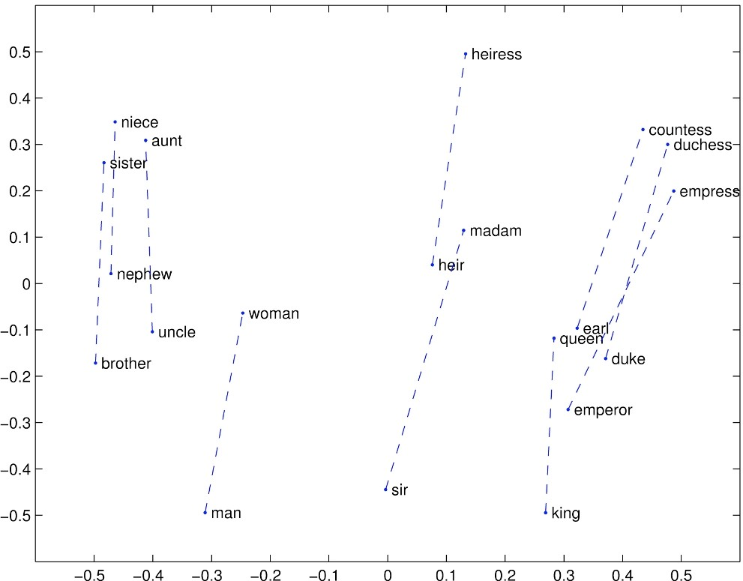
Conclusion: Representation for all levels? Vectors
We will study how we can learn vector representations for words and what they actually represent.
Next: how neural networks work and how they can use these vectors for all NLP levels and many different applications

Slide 27
https://xkcd.com/1576/
Randall Munroe CC BY NC 2.5
1/9/18

